Slide 1


Local SDI Dehradun
3.2(a):Technology and Standards for Geospatial Workflow
Course details:
M.Tech. in RS and GIS
Semester II
Module III
Presented to:
Kapil Oberai sir
Scientist SF
GID, IIRS, ISRO
Presented by:
Advaith C A (PRSD)
Sudikin Pramanik (GID)

Slide 2

CONTENT
1
Introduction
2
Objectives
3
Materials used
4
Methodology
5
Result and discussion
6
Acknowledgement
7
References

Slide 3
1
Introduction
We discuss in brief about SDI
The part one

Slide 4
SDI is framework for
Effective collection
Integration
Discovery
Sharing
Delivery
Utilization
The important points that needs to be kept in mind

Slide 5
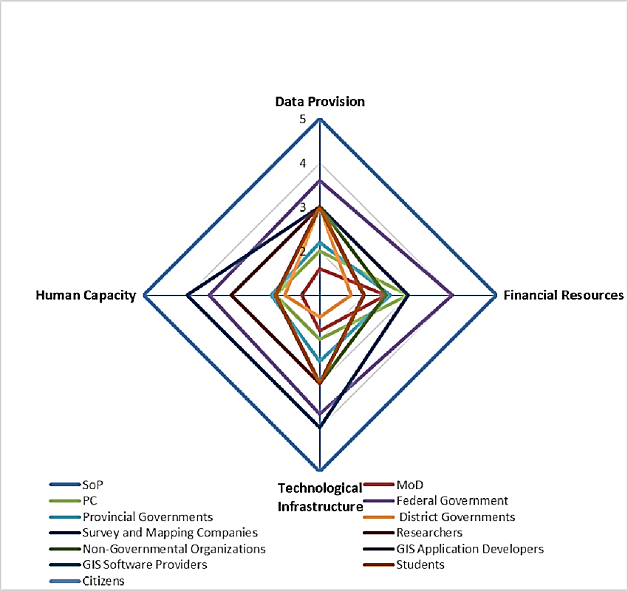
Resulting in
+
Awareness
Cooperation
How?
Whom?
There will be increased awareness in the use of geospatial data for the global community
Cooperation between decision-makers and stake-holders

Slide 6
Fig: National spatial data infrastructure stake holder diagram of Pakistan

Slide 7
Benefits of SDI
01
02
03
04
Removes duplication
Improves quality
Reduces cost
Establishes partnership
It reduces duplication by centralized data repository, standardization and interoperability
It maintains quality by producing comprehensive metadata, regular updates and maintenance and various quality control measures.
Elimination of redundant data collection, efficient resource allocation and reduced IT resource infrastructure cost.
It provides policy and legal framework, data sharing agreements, collaborative platforms and tools, governance structures and community building
PPT下载 http://www.1ppt.com/xiazai/

Slide 8


SDI of Dehradun
No active SDI
Creating and SDI for Dehradun district is necessary as it serves as an educational hub, tourism gateway, business center, administrative significance, military presence and good climatic conditions. The following things must be kept in mind while preparing an SDI.
Fig: Chakrata ©Aashu Punetha
Standards
Data
Resources
Various OGC and metadata standards
Multisource and multi type data
Various softwares and good hardwares

Slide 9
02
Objectives
This section describes what we want to do.
The part two

Slide 10
Add title text
Add title text
Add title text
Click here to add content, content to match the title. Click here to add content, content to match the title. Click here to add content, content to match the title. Click here to add content, content to match the title.
Add title text
65%
Add title text

Slide 11
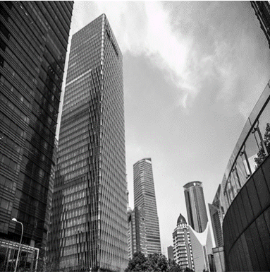
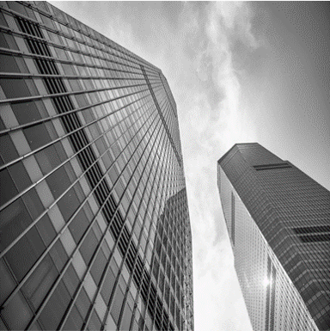



Add title text
$870
Add title text
Add title text
Add title text
Click here to add content, content to match the title.
Click here to add content, content to match the title.

Slide 12
Add title text
Add title text
Add title text
Click here to add content, content to match the title.
Click here to add content, content to match the title.
Add title text
Add title text
Add title text
Click here to add content, content to match the title.
Click here to add content, content to match the title.
Click here to add content, content to match the title.

Slide 13
LOGO
03
Add title text
Click here to add content, content to match the title.
The part three

Slide 14

Add title text
Add title text
Click here to add text content, such as keywords, some brief introductions, etc.Click here to add text content, such as keywords, some brief introductions, etc.
Add title text
Add title text
Click here to add content, content to match the title.
Click here to add content, content to match the title.
Add title text
Add title text
Click here to add content, content to match the title.
Click here to add content, content to match the title.

Slide 15

Add title text
Add the title text here
Click here to add text content, such as keywords, some brief introductions, etc.
Add title text
Click here to add text content, such as keywords, some brief introductions, etc.
Add title text
Click here to add text content, such as keywords, some brief introductions, etc.

Slide 16

Add title text
Add the title text here
Add title text
Add title text
Add title text
Add title text
$327
654
$241
70.21%
Add title text
Add title text
Add title text
Add title text
50%
70%
80%
95%
Click here to add content, content to match the title.
Click here to add content, content to match the title.
Click here to add content, content to match the title.
Click here to add content, content to match the title.

Slide 17
Add title text
Add the title text here
Click here to add content, content to match the title.
Click here to add content, content to match the title.
Add the title text here
Click here to add content, content to match the title.
Click here to add content, content to match the title.

Slide 18




Add title text
Click here to add text content, such as keywords, some brief introductions, etc.
Add the title text here
Add title text
Add title text
Add title text
Add title text
Add title text
Add title text
Add title text
Add title text

Slide 19


Add title text
Add the title text here
Add title text
Add title text
Add title text
Click here to add content, content to match the title.
Click here to add content, content to match the title.
Click here to add content, content to match the title.

Slide 20
LOGO
04
Add title text
Click here to add content, content to match the title.
The part four

Slide 21
Add title text
2023
Click here to add text content, such as keywords, some brief introductions, etc.
Add title text

Slide 22
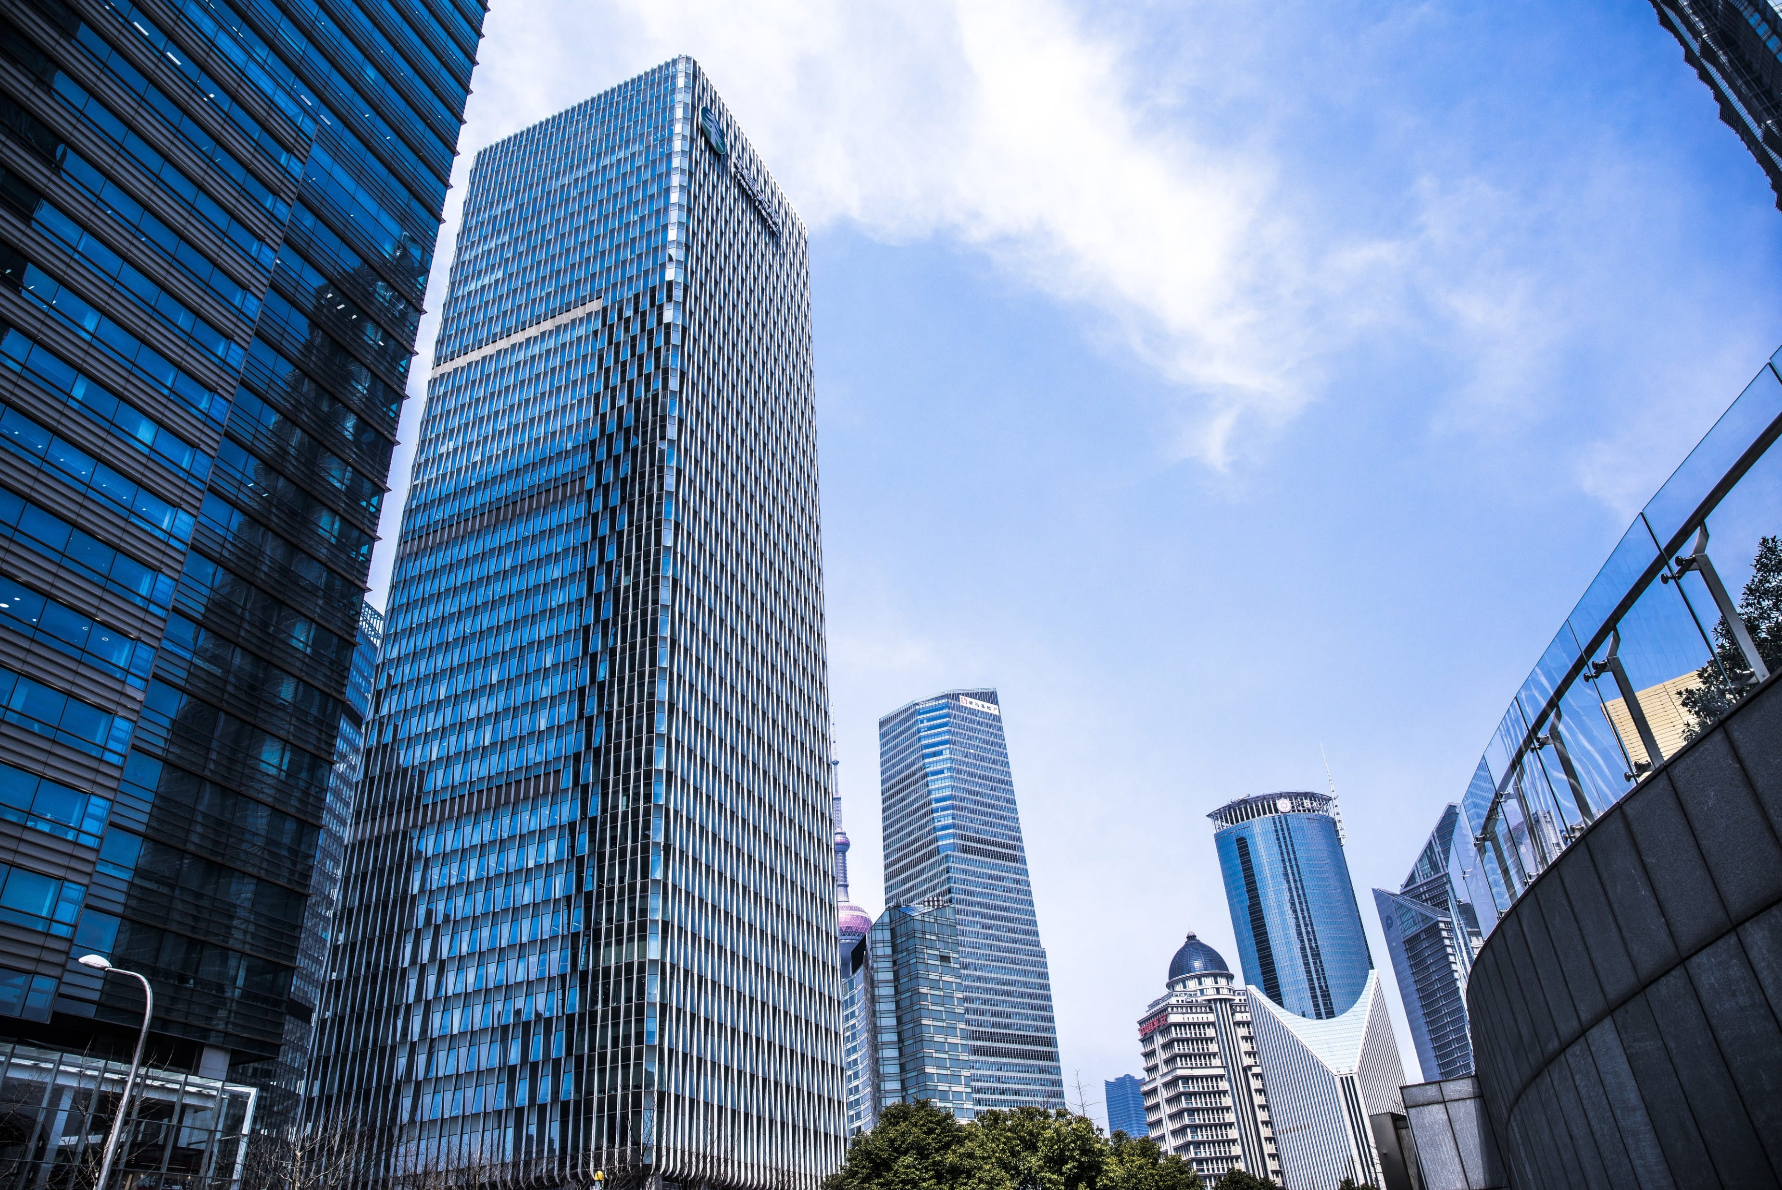
Add title text
16th
Add title text
Add title text
Click here to add text content, such as keywords, some brief introductions, etc.
Click here to add text content, such as keywords, some brief introductions, etc.
Add title text

Slide 23
Add title text
Click here to add content, content to match the title.
STEP
STEP
Click here to add content, content to match the title.
02
03
STEP
STEP
01
04
Click here to add content, content to match the title.
Click here to add content, content to match the title.

Slide 24
LOGO
05
Add title text
Click here to add content, content to match the title.
The part five

Slide 25

Add title text
Add title text
Click here to add content, content to match the title.
Click here to add content, content to match the title.
Click here to add content, content to match the title.

Slide 26


Add title text
Add title text
Add title text
25%
Add title text
45%
Add title text
30%
Click here to add content, content to match the title.

Slide 27
Add title text
Add title text
Add title text
Click here to add content, content to match the title.
Click here to add content, content to match the title.
Add title text
Add title text
Add title text
Click here to add content, content to match the title.
Click here to add content, content to match the title.
Click here to add content, content to match the title.

Slide 28
LOGO
06
Add title text
Click here to add content, content to match the title.
The part six

Slide 29

Add title text
Add title text
65%
Add title text
Click here to add content, content to match the title.
Add title text
Add title text
Click here to add content, content to match the title.
Add title text
Click here to add content, content to match the title.

Slide 30
Add title text
Add title text
Add title text
Add title text
Add title text
Click here to add content, content to match the title.
Click here to add content, content to match the title.
Click here to add content, content to match the title.
Click here to add content, content to match the title.
Add title text
Add title text
Add title text
Click here to add content, content to match the title.
Click here to add content, content to match the title.
Click here to add content, content to match the title.

Slide 31

Add title text
Add title text
Click here to add content, content to match the title.
Add title text
Click here to add content, content to match the title.
Add title text
Click here to add content, content to match the title.

Slide 32
Q&A time
Teachers, please raise my subject
valuable opinion!

Slide 33
THANKS
Thanks to my alma mater for providing valuable learning and practice opportunities!
Thanks to my mentor team!
Thank you students for your support and help!
Thank you all reviewers!

Slide 34
LOGO
THANK YOU
XXX Academy
Respondent:
Instructor:

